Slide 1
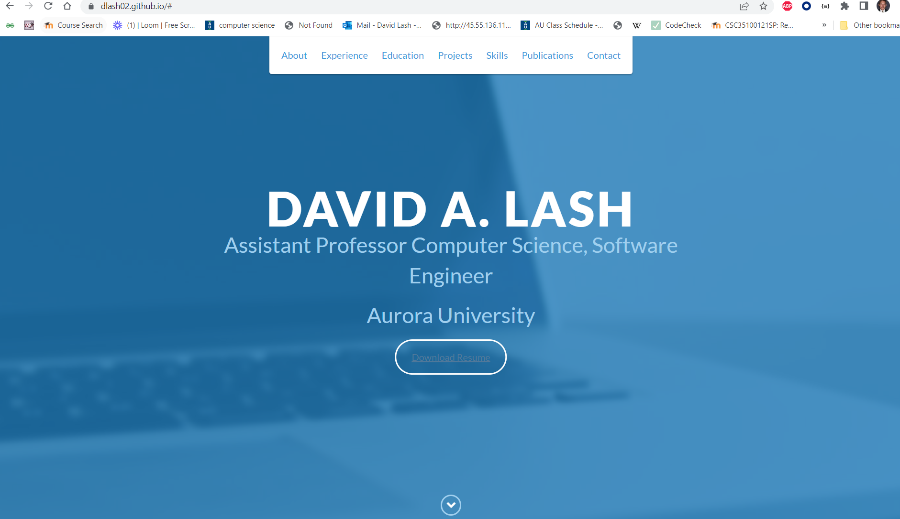
Get all this to work
Get the download to work

Slide 2
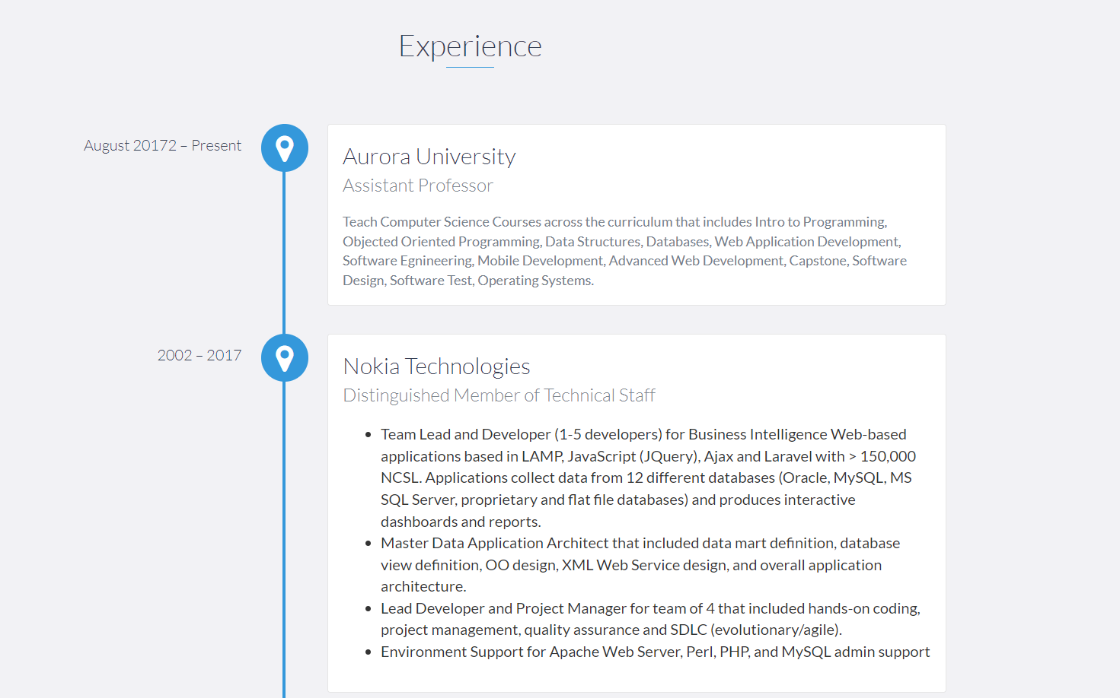
Have at least 2 experiences … if you only have 1 … then make up 1

Slide 3
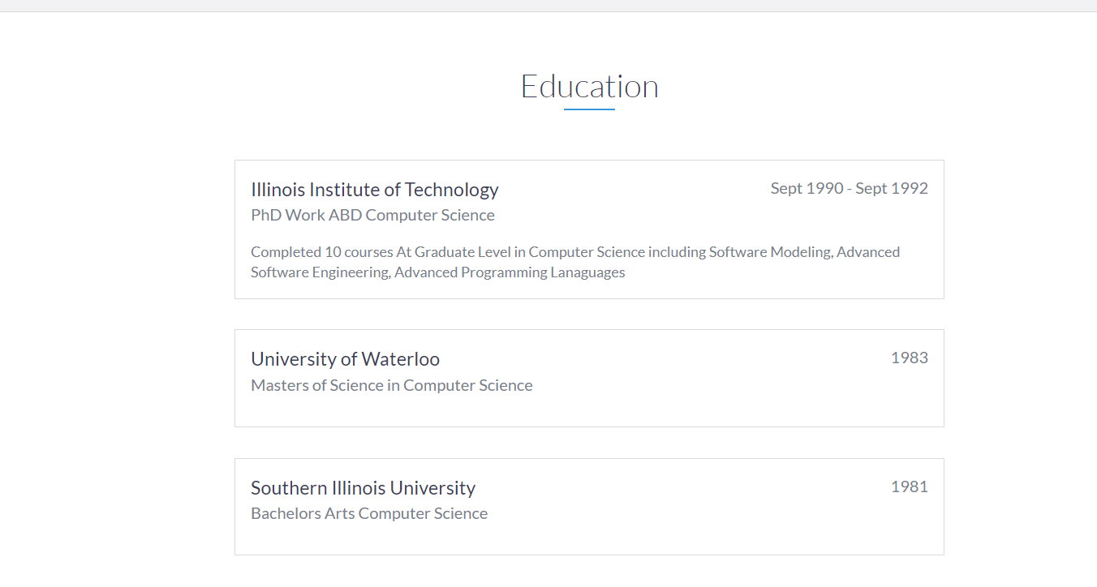
Add your expected graduation date and your major. Add other education experience if relevant

Slide 4
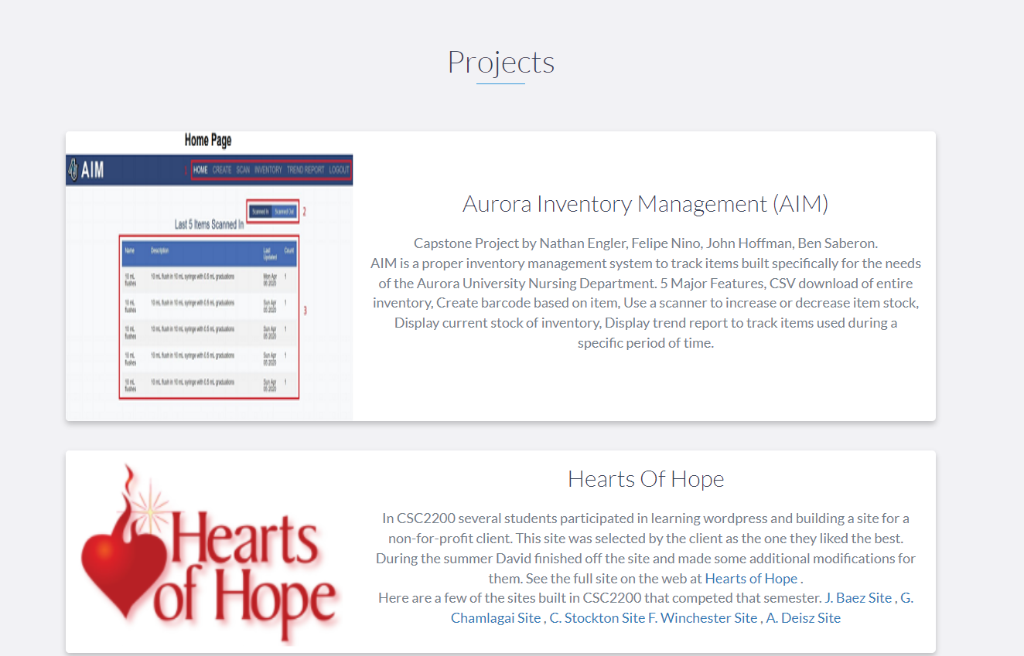
Add at least 2 projects with screen shot. If you have nothing add your first 2 homeworks with description
You need to have images here, a title and a 1 paragraph description for 2 projects

Slide 5
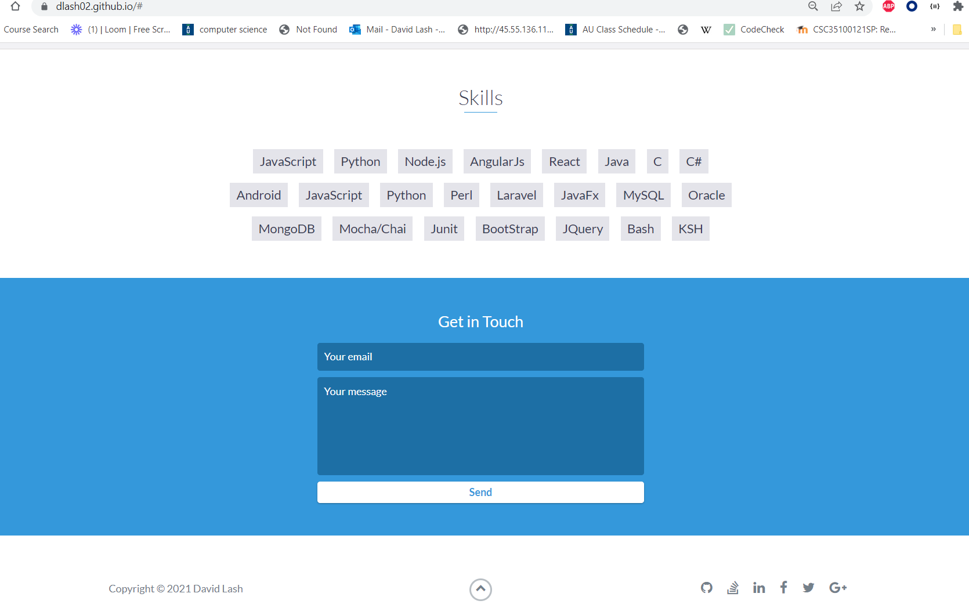
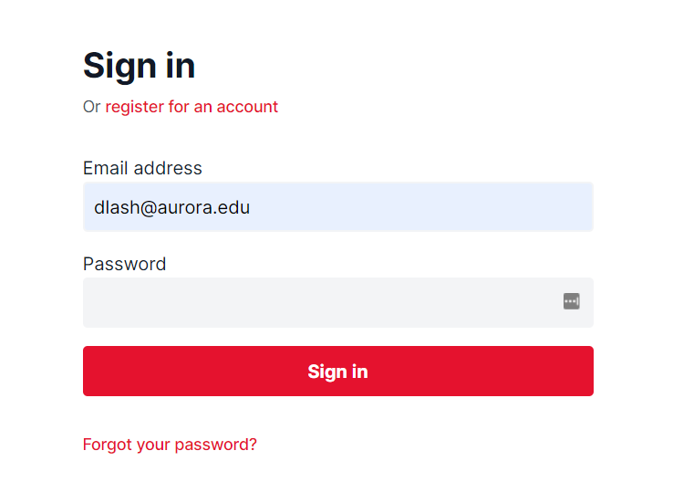
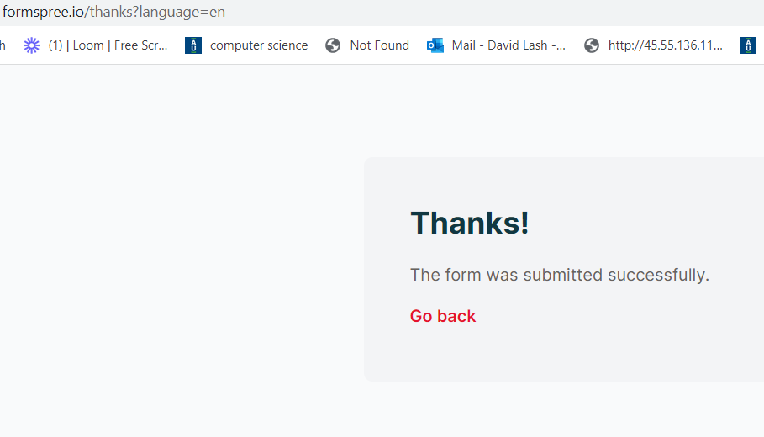
Add at least 5 skills
Update this …
Get this to work … need
<form method="POST" action="https://formspree.io/f/mlevnjvp"> where action is what formspree provides dor you after you create a form with them

Slide 6
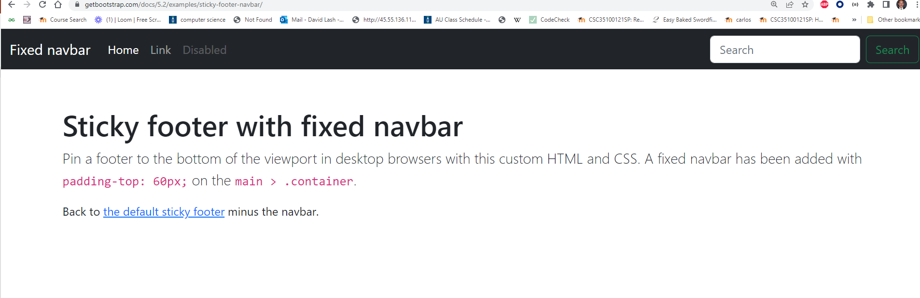
BootStrap Template
Pure BootStrap-
Grab the following bootstrap template:
https://getbootstrap.com/docs/5.2/examples/sticky-footer-navbar/

Slide 7
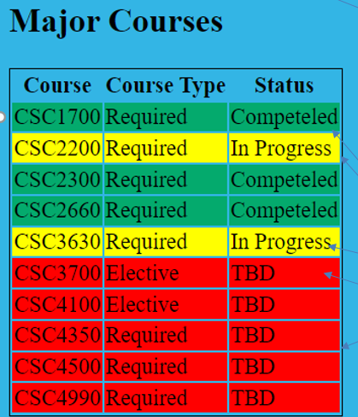
Remove the search box and button
Make change this Link to Portfolio and
Make it link to giuhub portfolio
yourID.github.io …
Make another line called HW and link to 1 HW
Put a jumboTron here that says:
Your_name Main Site
Create a color scheme that includes your
Nav bar that is NOT one of bootstraps defaults
Add a background color for page.
Style link colors in the color scheme.
Using the grid system
Place a picture of you 25% from the left
Underneath that image place this table with an
External CSS working correctly.

Slide 8
What to hand in
Publish your portfolio on github. That is: your_name.github.it
Publish your bootstrap page on 45.55.136.114
Make sure everything works.
Include a link to both pages in the comments of the assignment.
DOUBLE CHECK YOUR URL
IF your link does not work … you will not get credit for the assignment.
You will be graded by the quality of your portfolio content and the proper presentation using bootstrap

